Slide 1

Business Intelligence
Using Power BI
By: Venkateshwarlu Kummari

Slide 2
Contents
Definition
Architecture
Data
Power BI Desktop Software
Live Demo Of AB Retail
Power BI Services
History

Slide 3
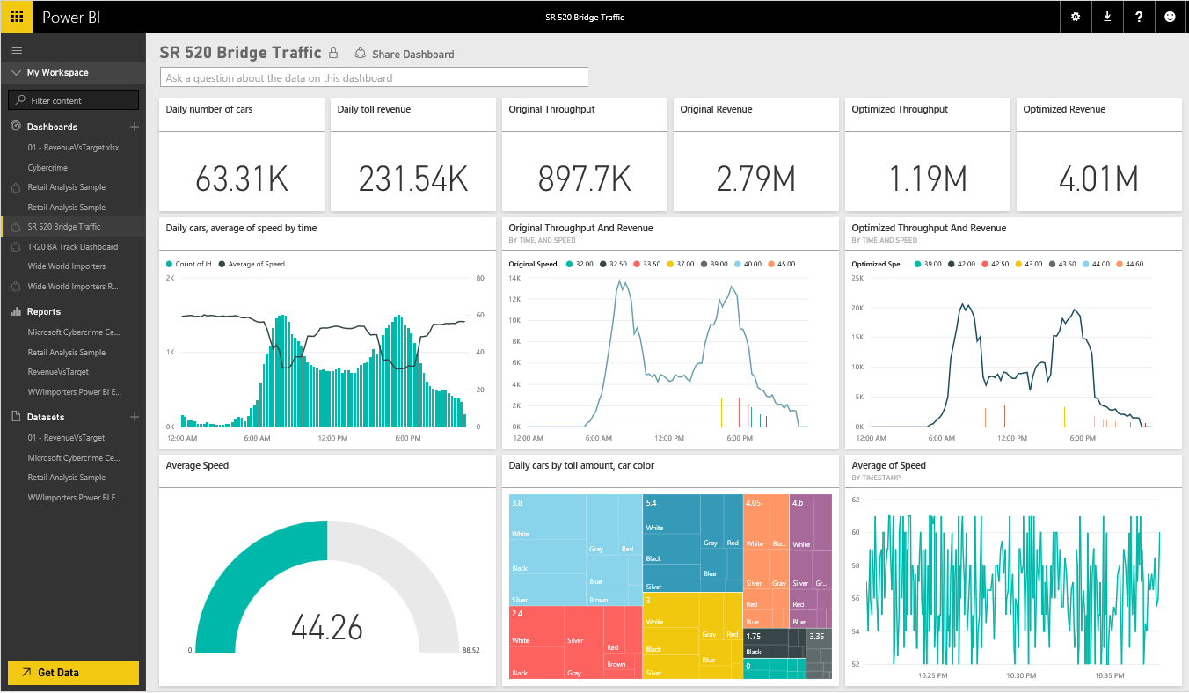

Introducing Microsoft Power BI
Experience your data. Any data, any way, anywhere.
Power BI is a cloud-based business analytics service that enables:
Fast and easy access to data
A live 360º view of the business
Data discovery and exploration
Insights from any device
Collaboration across the organization
Anyone to visualize and analyze data
Power BI
Notes:
Key message:
Power BI is a business analytics service. With Power BI you can now see all of your data through a single pane of glass. Live Power BI dashboards and reports show visualizations and KPIs from data residing both on-premises and in the cloud, providing a consolidated view across your business regardless of where your data lives.
Talking points:
This is Power BI in a nutshell and the overall benefits to your business. We will look at what this means for the IT Pro and the key benefits for IT on the next slide

Slide 4
A new generation of BI
Turning data into business insights is challenging
Common BI challenges include…
End-to-end view
Data often resides in disparate locations, making it difficult to see a complete picture of your business
Multiple data sources
Data residing in SaaS solutions, and other external locations, is difficult to access and refresh securely
Right data for the right users at the right time
Different roles have different needs, and business users need the latest operational data
Notes:
Power BI addresses three common business intelligence challenges that an organization may face:
Getting an end-to-end view off what is happening — because data is often in disparate locations, it can be difficult for business users to see a complete picture of your business
Managing multiple data sources — Data residing in SaaS solutions and other external locations can be difficult to manage programmatically, or access and refresh securely
Making the right data available to the right users at the right time
Mobile business users need the latest operational data at their fingertips, no matter where they are or what device they’re using
Different roles have different needs and access levels, so a one-size-fits all solution doesn’t work

Slide 5
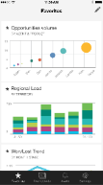
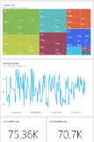
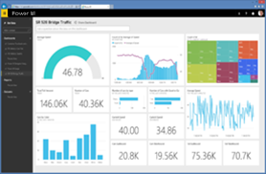
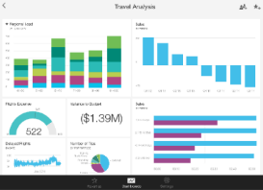

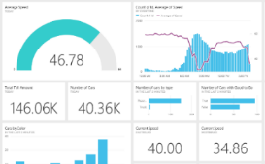


Power BI overview
Data sources
Power BI service
SaaS solutions
E.g. Marketo, Salesforce, GitHub, Google analytics
Content packs
Natural language query
Sharing & collaboration
On-premises data
E.g. Analysis Services
Live dashboards
Organizational content packs Corporate data sources, or external data services
Visualizations
Azure services
E.g. Azure SQL, Stream Analytics
Reports
Excel files
Workbook data or data models
01001
10101
Power BI Desktop files
Related data from files, databases, Azure, and other sources
Datasets
Data refresh

Slide 6
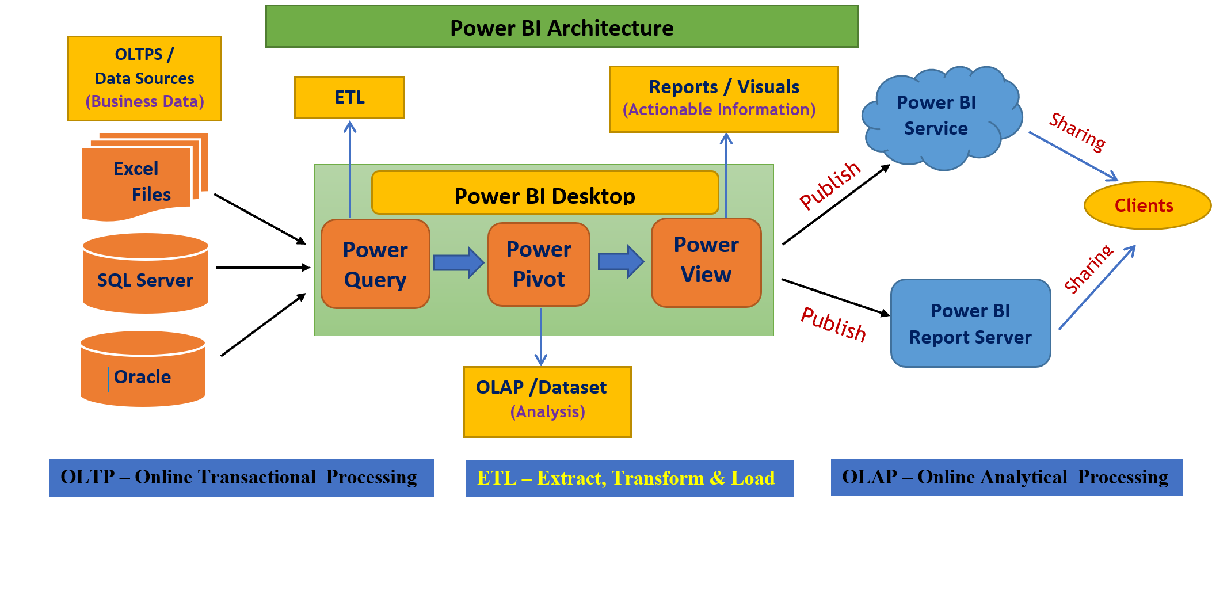
Power BI Reporting life cycle
Preparing the data and Loading into Reporting Tool → Power Query
Data Modeling and defining Metrics → Power Pivot
Report generation → Power View
Creating Dashboards, Sharing & Admin Activities → Power BI Service or Power BI Report Server
Viewing Reports & Dashboards → Mobiles and Web Browsers.

Slide 7
Retail Dashboard In Power BI
This comprehensive retail dashboard created with Power BI encompasses all-important analytics and metrics that are of great value to the retail business and offers enhanced visibility. Categorized in different segments like sales, profit, order, and shipping, the live dashboard depicts drill down details offering better forecasting and timesaving efficacy.
The enriched retail dashboard overview offers a detailed, real-time view into the summary of major parameters like gross sales and profit, total countries served, the best month for receiving orders, and items sold in a particular year. The retail analytics dashboards offer an effective data visualization experience, with all required information in a single go, based on category, sub-category, and product.
The dashboard offers robust Power BI row-level security features that control the access to rows and implements restrictions, based on user privileges and authentication. Specific security roles and role-based filters can be defined within the dashboard, to ensure effective row-level security.

Slide 8
Focus Metrics:
Sales: Region-wise/category wise sales, top countries where the sale is highest, top-performing products, and month-wise sales trend
Profits: Monthly profits, profitable/unprofitable regions, category/sub-category wise profits, most profitable customers
Orders: Details of orders received category and sub-category wise, location and segment-wise, customers who ordered most, the effect of orders received on profits
Shipping: Shipping details like the cost for shipping, customer preference, and locations where products were shipped, the average cost of shipping as against total shipment
Notes:
Consider talking about:
Historical predictions

Slide 9
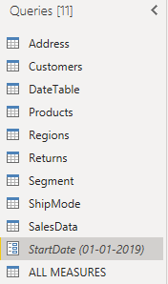
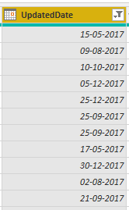
Retail AB Dataset :
Source Data : SQL Server
Dataset Name : Retail Database
Contains 9 Tables [1 fact table & 8 dimensional tables]
Sales Table Change to the Updated DateTable,
Column Data-Type to Date Data-Type.
Created a Parameters Called StartDate.
Assigned This Parameters to Update date Column.

Slide 10
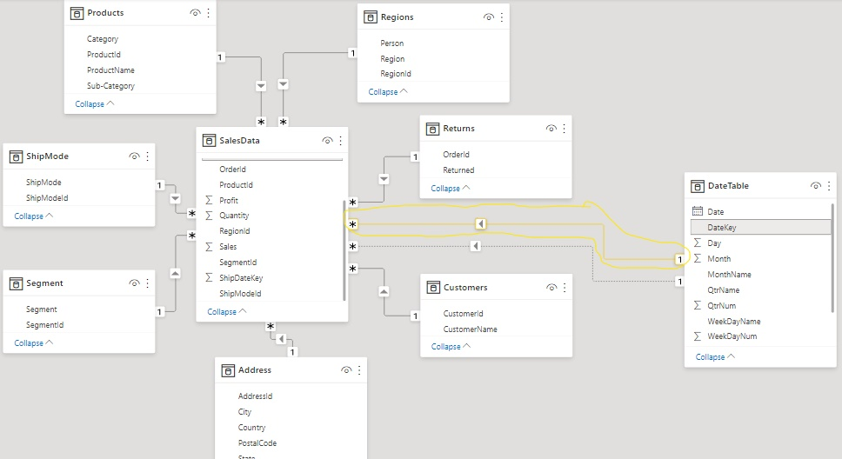
Power Querying:
Loaded all the Nine Tables Into Power Pivot.
Ensured that all the tables are properly related to each other through common columns.
Created the Relationship Between Data Table and Sales Table Using Common Column (Date Key Column) in Date Table, (OrderDatekey & ShipDateKey) in Sales Table.
Ensured Active Relationship Should Be (OrderDateKey & DateKey) as shown in the figure.
Given the Relationship Between Returns Table and sales Table.
Finally Prepare the Model as Shown in the Figure.
Star Schema Resulted.

Slide 11
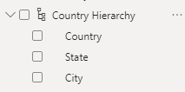
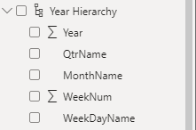
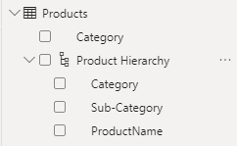
Power Pivot (Modelling the data)
Create Three Hierarchies.
1) Hierarchy to show Year, Quarter, Month, WeekName, Weekday Wise Data in a Single Visual.
2) Hierarchy to Show Category, Sub-Category, Product Wise Data in a Single Visual.
3) Hierarchy to show Country, State, City Wise data in a single Visual.
Stopped the Default Date Hierarchies.
Sort The Month Name Column Based on the Month Number Column.

Slide 12



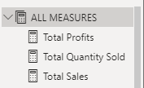
In Date Table Derive the FY-Year Column (Month Need to Start With “April” and ends with “March”) Using DAX Functions.
In the same Way Derive The FY-Qtr Column (Qtr1=April-June, Qtr2=July-sept, Qtr3=Oct-Dec, Qtr4 Jan-March) Using DAX Functions.
You Need to short the Month Name Column by MonthNum Column
Declare This as date Table
Related this DATE Table with Transactions Table.
Derived the Cost Price Column Using Sales, Quantity, Profits Columns as shown in the Figure.
Created New Table which is supposed to act as a Parking Table for all Measures and Renamed It as “ALLMEASURES” to understand what it holds.
Create The Measures Using Existing Fact Columns In The Sales Table
Ex:- Sum Of Sales, Total Quantity, Total Discount, Total Profits.

Slide 13
Power BI Service Connection
Created a Workspace in Power BI Service Called RetailAB.
Publish This Dataset to the RetailAB Workspace.
Downloaded the DATA GATEWAY and Install it in The Server Machine from Where You are Getting the Data.
Added the Data Source Connections to the Gateway
Configure This connection to the RetailAB Dataset.
Change the Startdate Parameter to Startdate = 1/1/2017 in Parameter Settings
Now Click on Refresh to Get the Entire Data to the Workspace.
Treated The below 3 Pages as One Report and Name This Report as Retail AB Report 1.
Make Sure That all The Requirements Should be Correct.
After Developing all the Pages Publish This Report to Retail AB Workspace.

Slide 14
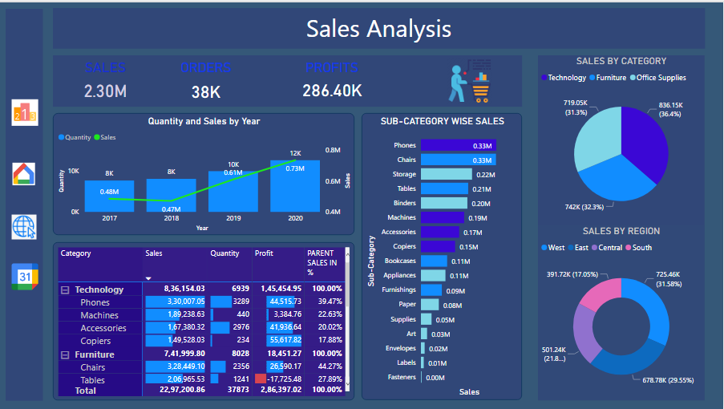
Created a Page Named “Sales Analysis”. Colors, Fonts, Position Of the Visuals are as of Choice.
Visual You Need to Present:
3 Cards, 1 Combo Chart (Line and Clustered Column Chart)
1 Stacked Bar Chart to Show Sub-Category wise sales,
1 Pie-Chart to Show Category Wise Sales.
1 Donut-Chart to Show Region Wise Sales.
Created a Matrix Visual as shown in the Image Use ALLEXCEPT Dax Function to Get the Parent sales in Percentages.
Created Drill Through on a Region Column to Region Wise Analysis Page.

Slide 15
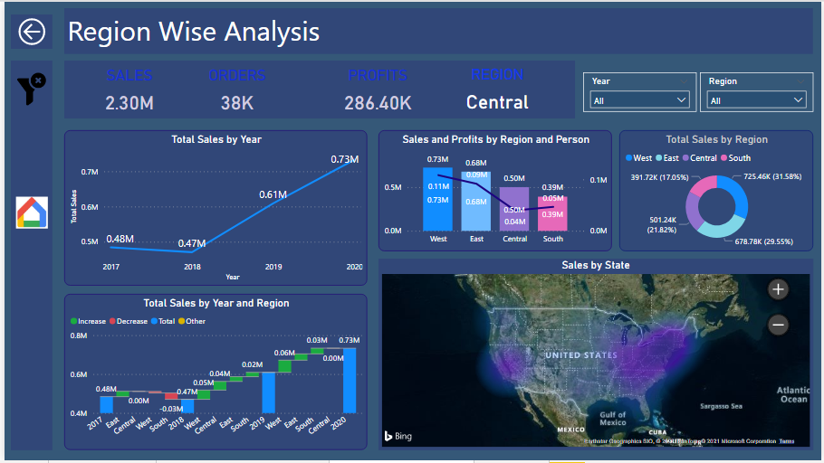
Created a Report Page called “Region Wise Analysis”.
Visuals Need to keep in This Report Page are:
4 Card Visuals (sales, Orders, Profits, Regions).
2 Slicers (Year and Region).
1 Line Chart to show Year Wise sales.
1 Combo Chart to Show sales and Profits by Region and Person
1 Donut Chart to Show Region Wise Sales.
Created a Waterfall Chart to Show Year and Region Wise Sum of Sales.
Created Map Visual to show State Wise sales. (Map Should be Heat map)
Created Drill Through on Region Column.
Create a Bookmark to Clear all the Filters at a Time.
Create a Page Navigation to Go to Main Page by Clicking on the Home Image.

Slide 16
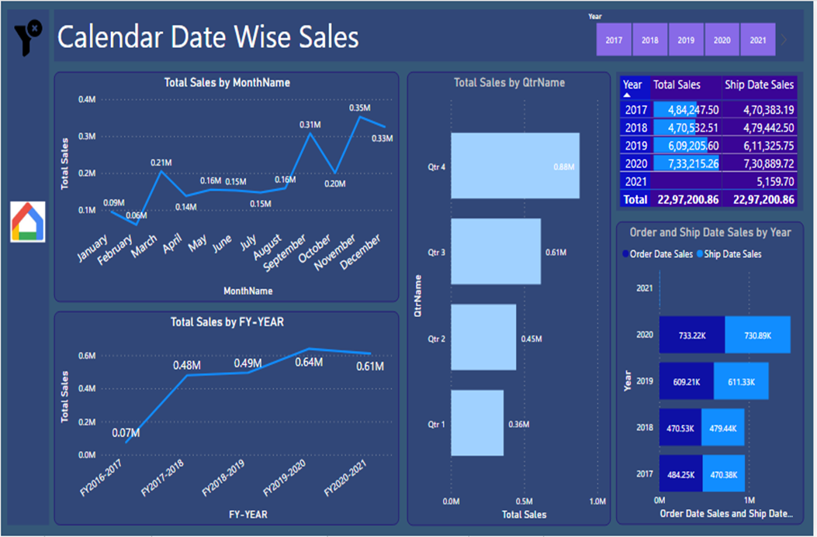
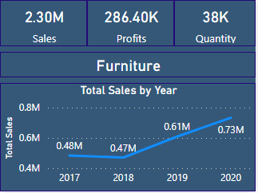
Created a Report Page called “Calendar Date Wise sales”.
1 Slicer to show the Years.
1 Line Chart to Show Month Wise Sales.
1 More Line Chart to Show FY-Year Wise Sales.
1 Stacked Column Chart to show QTR Wise sales.
1 Table Visual to Show Year wise Order Date and Ship date sales.
Shown the same Data in Stacked Column Chart.
Created a Bookmark to Clear all the Filters at a Time.
Created a Page Navigation to Go to Main Page by Clicking on the Home Image.
Created a Custom ToolTip and Show it on the Visual Category Wise Sales As Shown in the Visualization.
Assigned this Tooltip to the Pie Chart visual in the Main page.
Created the Page Navigations to all the Four Pages.

Slide 17
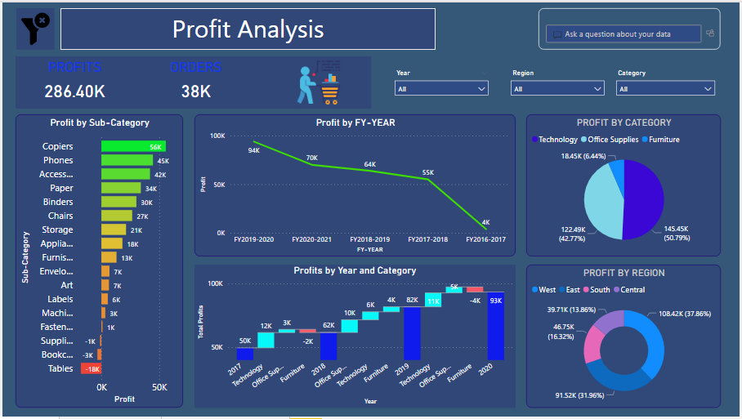
RetailAB Report 2(Profit Analysis)
Created a Report Page called “Profit Analysis”.
2 Card Visuals to Show Profits and Orders.
3 Slicers Visuals for Year, Region, Category.
1 Stacked Column Chart to Show Sub-Category Wise Profits.
1 Line Chart to Show FY-Year Wise Profits.
1 Waterfall Chart to Show Year Wise Category Wise Profits.
1 Pie-Chart to show Category Wise Sales.
1 Donut Chart to show Region Wise Sales.
Placed One Q&A Visual in This Report Page.
Created a Bookmark to Clear all Slicer Filters
Assigned this Bookmark to the Clear filter Image Which is their on the Top.

Slide 18
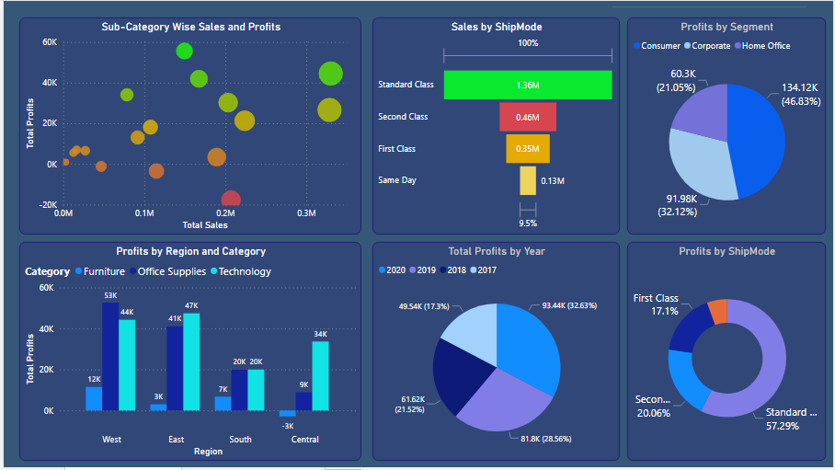
Created a Visual to Show Sub-Category Wise Sales and Profits. (To Identify Which Sub-category Is Getting More Sales and More Profits)
The Purpose Of This Visual is to Compare two Fact Values Based On The Single Dimensional Column.
1 Funnel Chart to Identify Which Mode of Shipments Is Preferred by the Customers.
Created a Clustered Chart to show Region and Category wise Profits.
Created a Visual to Show to Show Segment Wise Profits.
Created a Visual to show Year Wise Profit.
Created a Visual to show Ship Mode wise Profits in Percentages.

Slide 19
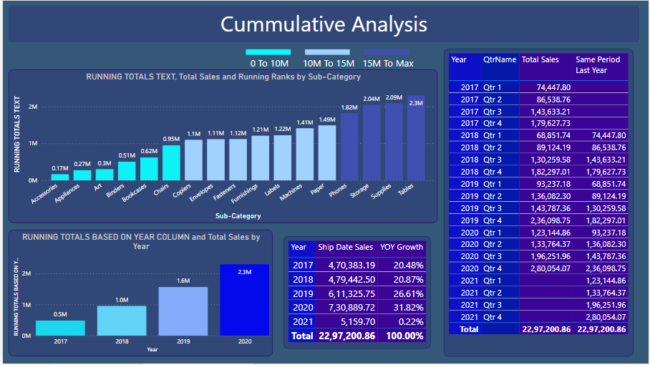

Created a visual to Show Running Totals (or) Cumulative Totals based on the Sub-Category Column. i.e., Text Column and Given Ranking Based on the Running Totals.
Created a visual to Show Running Totals (or) Cumulative Totals based on the Date Column. i.e., Year Column.
Created a table visual to Show Ship Date wise Sales and their Growth in Percentages.
Created a Table Visual to Show Qtr Wise Cumulative Totals Use Total QTD Dax Function.
Created a Custom Legend to Show the Conditional Color Formatting of the Visual.

Slide 20
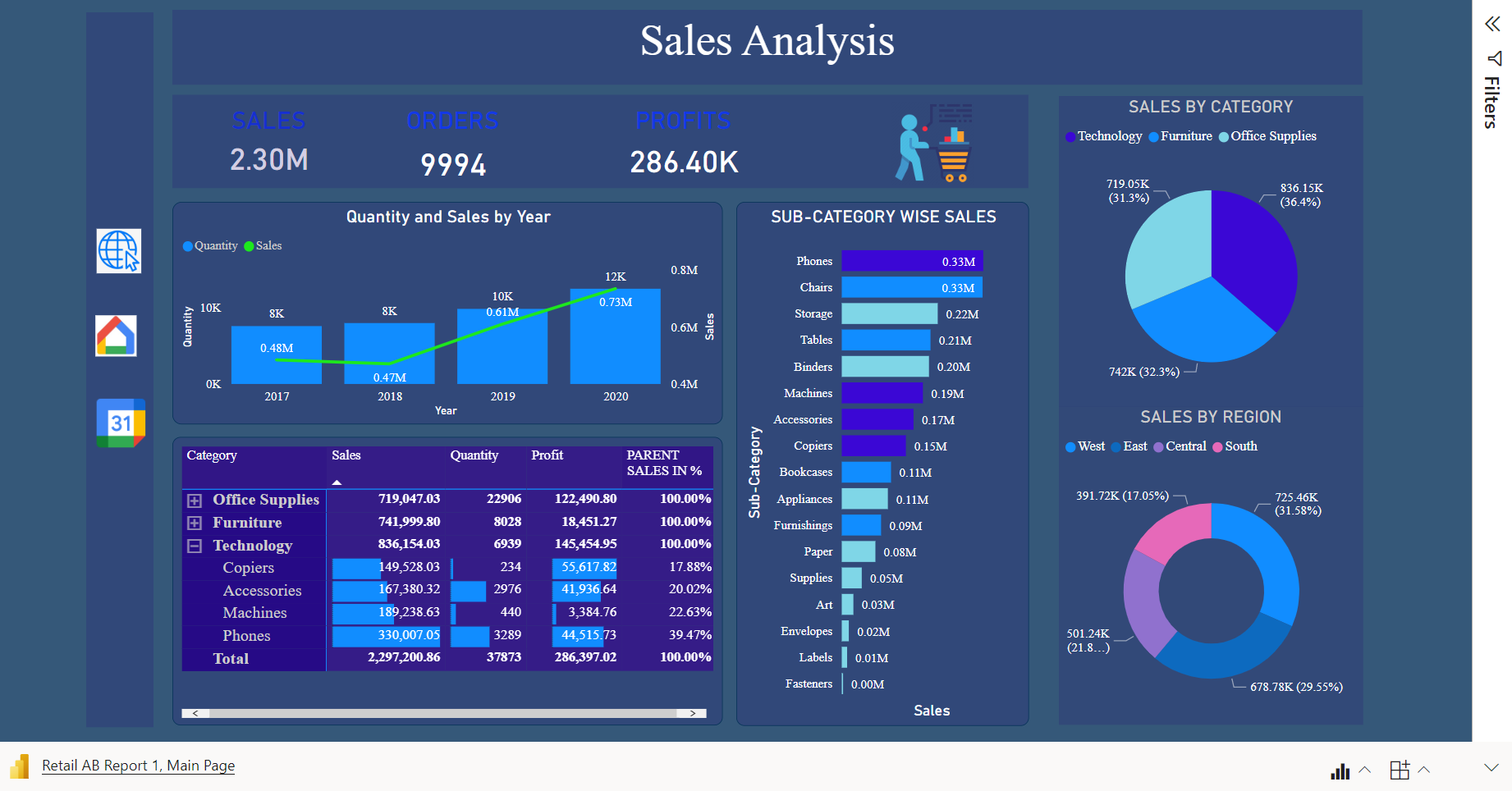
Live Interactive Power Bi Report (Ab Retail Sales Analysis)

Slide 21
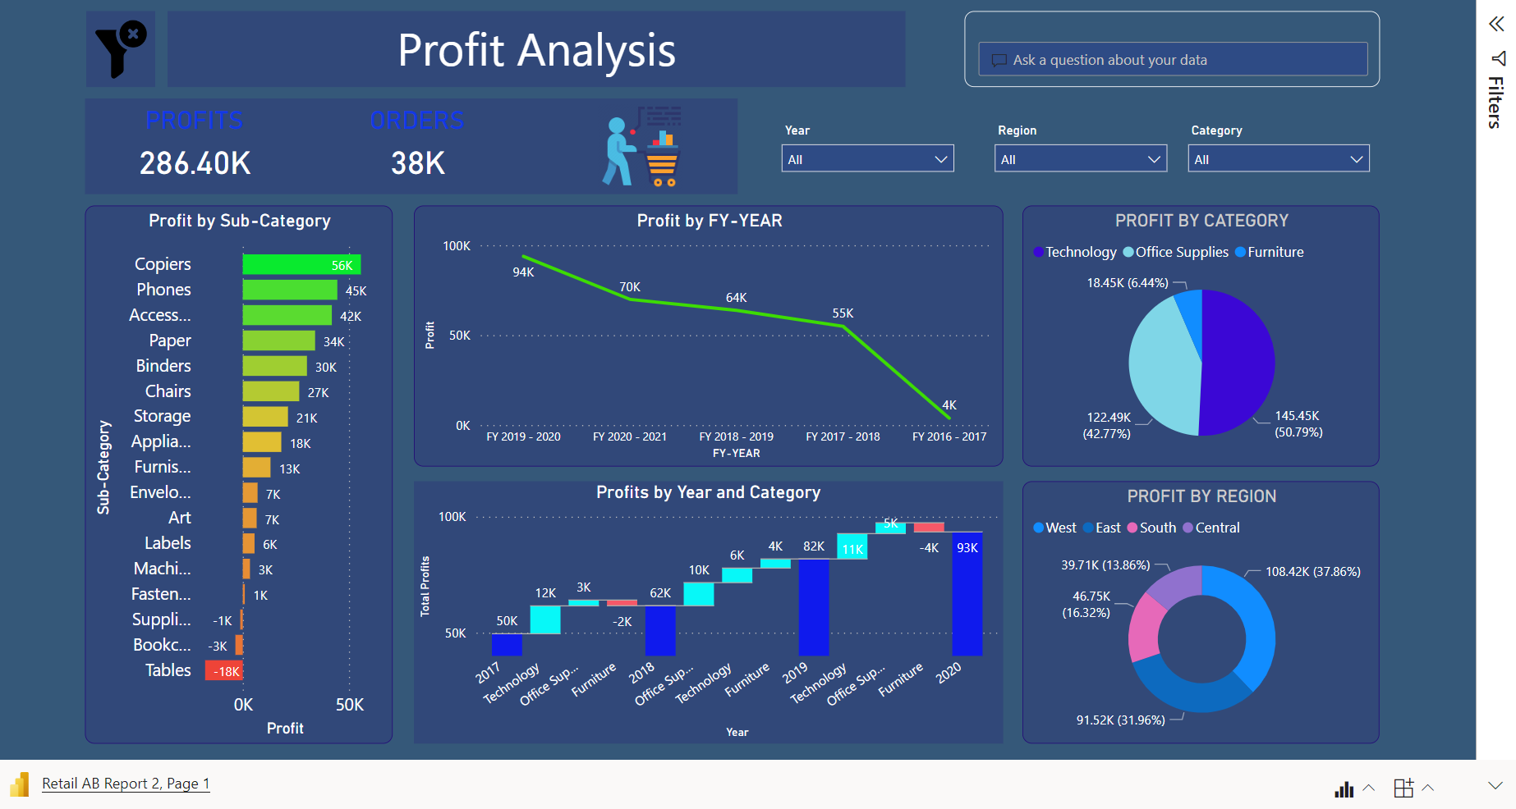
Live Interactive Power Bi Report (Ab Retail Profit Analysis)

Slide 22

Thanks for the Opportunity!

